Slide 1
Hardware Architecture and Software Stack for PIM Based on Commercial DRAM Technology
Conference : ISCA-2021
Author : Sukhan Lee, Shin-haeng Kang, Jaehoon Lee, Hyeonsu Kim, Eojin Lee……
Research unit : Samsung Electronics

Slide 2
Research work—Background
Emerging applications such as deep neural network demand high off-chip memory bandwidth.
Level1 BLAS(scalar-vector and vector-vector operations) and Level2 BLAS(vector-matrix operations) do not benefit from on-chip cache caused the Memeory-Bound.
Transferring data across the memory hierarchy constitutes a large fraction of total energy consumption .
Transferring data from off-chip DRAM to processor consumes two orders of magnitude more energy than floating point operation
The 2.5D/3D stack DRAM emerge to expand the bandwidth of the system.
The bandwidth of HBM2 can achieve 256GB/s.

Slide 3
Research work—Problem
Even with HBM, modern DNN still suffer from limited memory bandwidth.
The new architectures often require change the host processor and/or application codes which memory manufacture cannot govern.

Slide 4
Research work—Motivation & Solution
Combine the PIM and HBM2 technique and develop the soft-stack to run the existing code without changes.

Slide 5
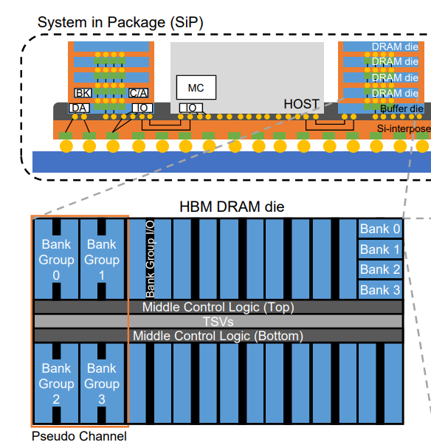
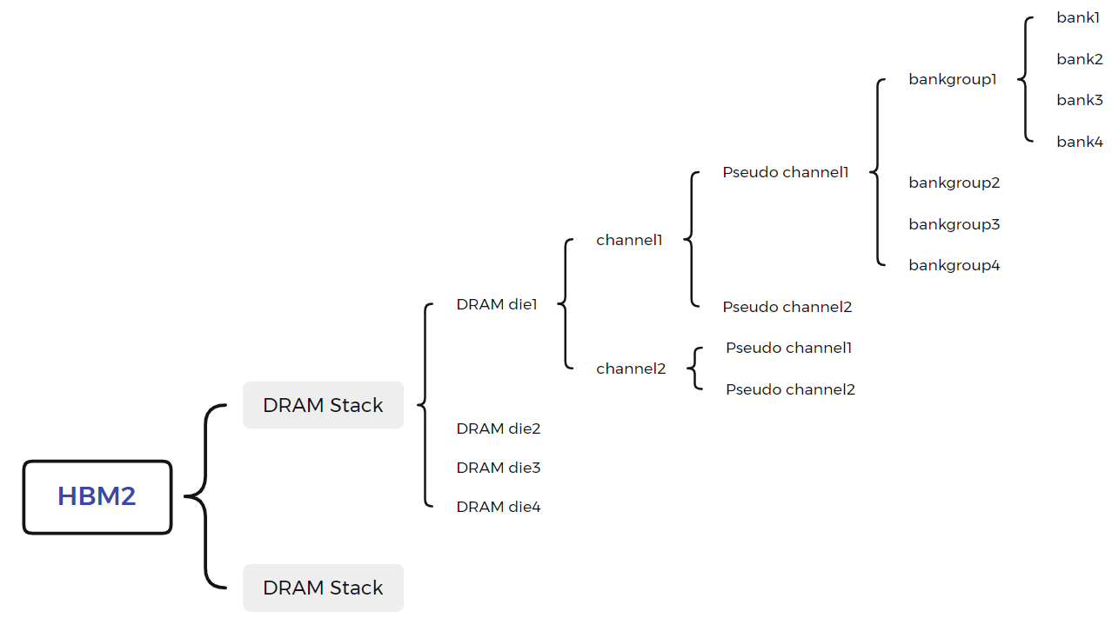
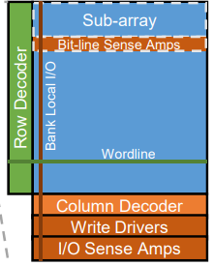
Research work—Preliminaries
High Bandwidth Memory(HBM).

Slide 6
Research work—Preliminaries
High Bandwidth Memory(HBM).
Each time access a bank of a Pch, different Pch accessed simultaneously.
Two Pches of one channel share the bank number/row address/column address .
The interface bandwidth of a Pch is 64bit.
Adopt DDR technique, the transfer rate of a Pch is 128bit/s.
Under 1GHz, the bandwidth of a Pch is 16GB/S.
Under 1GHz ,the bandwidth of 16 Pch is 256GB/S.

Slide 7
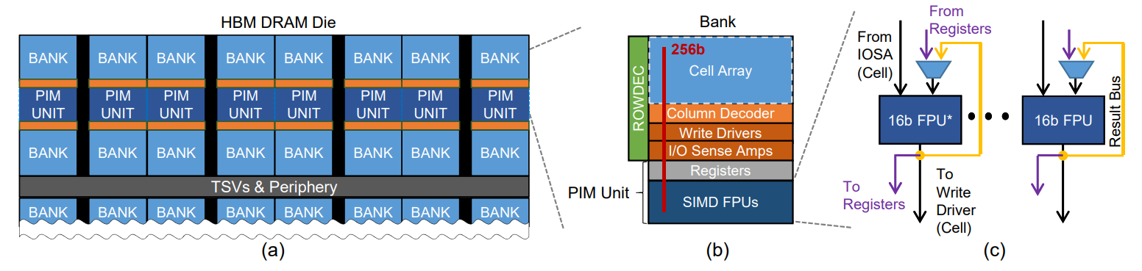
Research work—Challenge and Technique
PIM-DRAM Architecture.
Architecture overview.
1) - PIM-DRAM die.
2) - Bank coupled with a PIM execution.
(1). A single instruction multiple data(SIMD) floating-point unit - 16 FPUs to get 16 16bit data from IOSA/register/databus.
(2). Registers.
a. command registers files(CRG) - store PIM instructions.
b. general register files(GRF) - store source operand and destination operand.
c. scale register files(SRF) - store source operand.

Slide 8
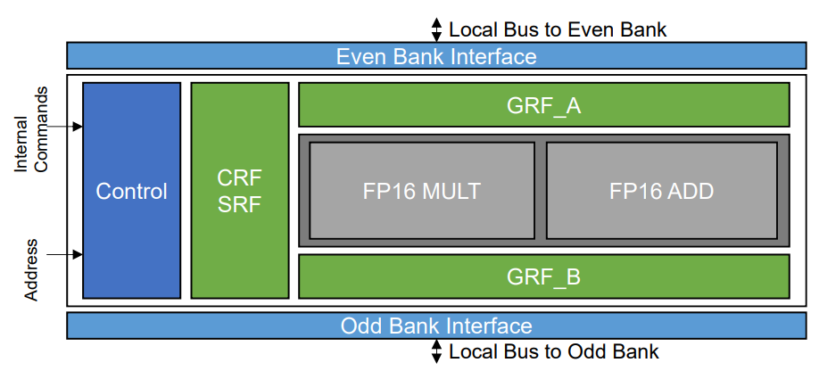
Research work—Challenge and Technique
PIM-DRAM Architecture.
PIM Microarchitecture.
1. A PIM execution is placed between two banks.
2. A PIM execution consists of three components:
1) – 16-wide SIMD FPU.
(1) The FPU consists a pair of 16 FP16 multipliers and adders.
2) – register files.
(1) Command Register Files(CFR): as an instruction buffer comprises 32 32-bit register.
(2) General Register Files(GFR):
a. GRF_A,8*256bit for EVEN bank; GRF_B,8*256bit for ODD bank.
(3) Scalar Register Files(SFR).

Slide 9
Research work—Challenge and Technique
PIM-DRAM Architecture.
PIM Microarchitecture.
1. A PIM execution is placed between two banks.
2. A PIM execution consists of three components:
1) – 16-wide SIMD FPU.
2) – register files.
(1) Command Register Files(CFR).
(2) General Register Files(GFR).
(3) Scalar Register Files(SFR) : SRF_A - 8*256bit for FP16 ADD ; SRF_B – 8*256bit for FP16 MULT.
a. Replicating a given 16-bit value by 16 times.
b. Supplying them to the 16-wide SIMD FPU as one of source operands.

Slide 10
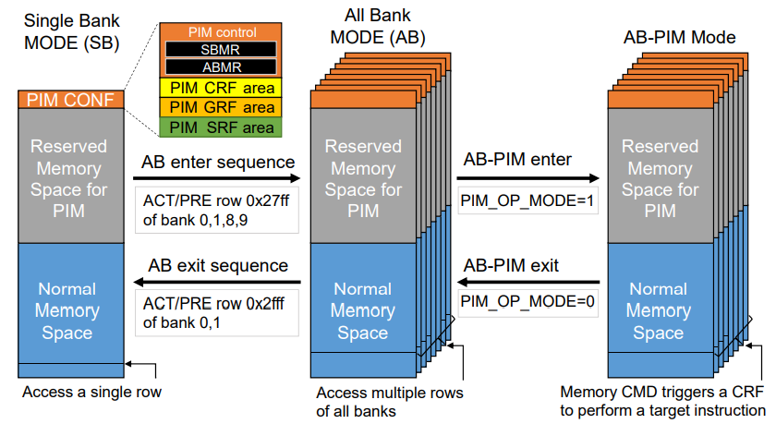
Research work—Challenge and Technique
PIM-DRAM Architecture.
Bank-Level parallelism for PIM.
Single Bank Mode – only a single bank is activated of a pCH .
All Bank Mode - all 16 banks of a pCH are activated.
(1) The same row and column of all bank of a pCH are accessed simultaneously.
(2) PIM-HBM with 16 banks per pCH provide 8x higher on-chip bandwidth than HBM2.
eg.HBM can provide 256GB/s bandwidth for 16pCH so that PIM-HBM can provide 2TB/s for 16pCH.
3) All Bank PIM Mode.
(1) A DRAM column command trigger a instruction execution then update a PIM program counter to get the next instruction.

Slide 11
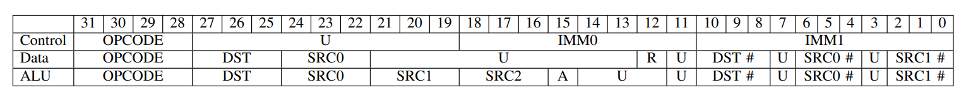
Research work—Challenge and Technique
PIM-DRAM Architecture.
Instruction Set Architecture – Instruction format.
1) Flow-control instruction.
NOP/JUMP/EXIT.
2) Data movement instruction.
FILL/MOV(ReLU) – storing and loading data to/from the register in a PIM execution unit.
‘R’ denote this instruction completes the ReLU function.
3) Arithmetic instruction.
ADD/MUL/MAD/MAC – for accelerating ML acceleration.
‘A’ denote whether in address aligned mode.

Slide 12
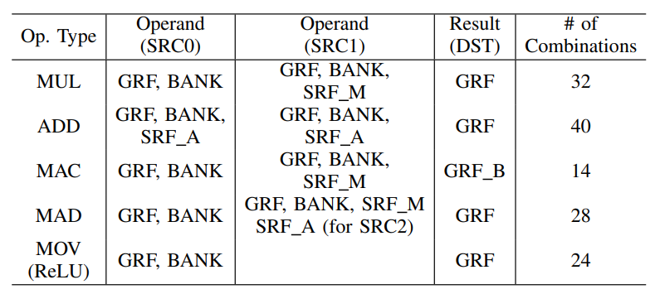
Research work—Challenge and Technique
PIM-DRAM Architecture.
Instruction Set Architecture – All the PIM operation.
MAC :
DST SRC0 SRC1 SRC2
GRF_B = GRF_A * BANK + GRF_B --- DST & SRC2 are the same register.
2. MAD :
DST SRC0 SRC1 SRC2
GRF_A = BANK * SRF_M + SRF_A --- SRC1 & SRC2 have the same register index in different register file.

Slide 13
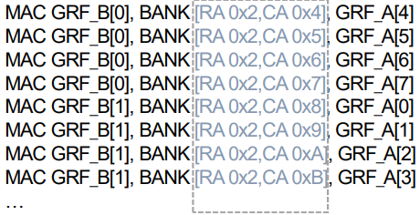
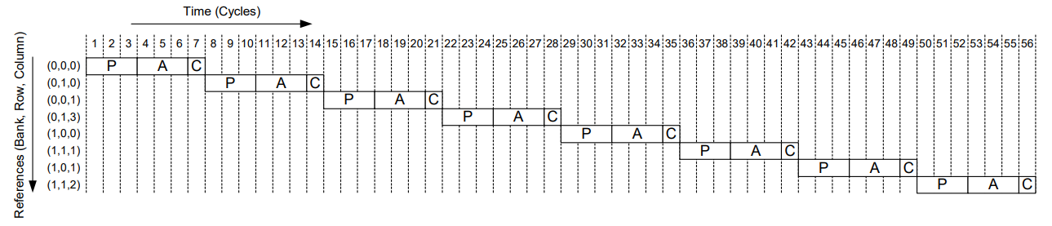
Research work—Challenge and Technique
PIM-DRAM Architecture.
Instruction Set Architecture – Instruction ordering.
P:Precharge
A:Row Activation
C:Colunm Access

Slide 14
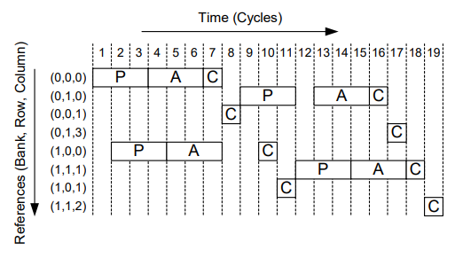
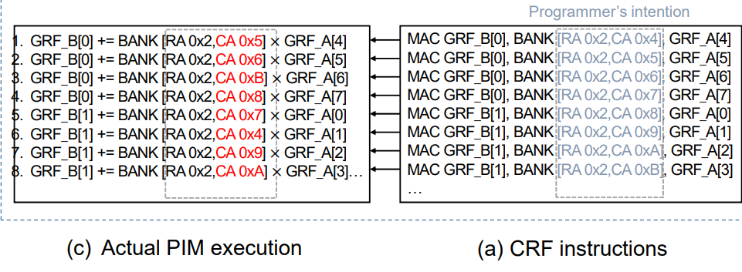
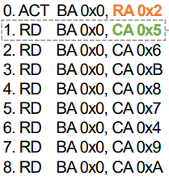
Research work—Challenge and Technique
PIM-DRAM Architecture.
Instruction Set Architecture – Instruction ordering.

Slide 15
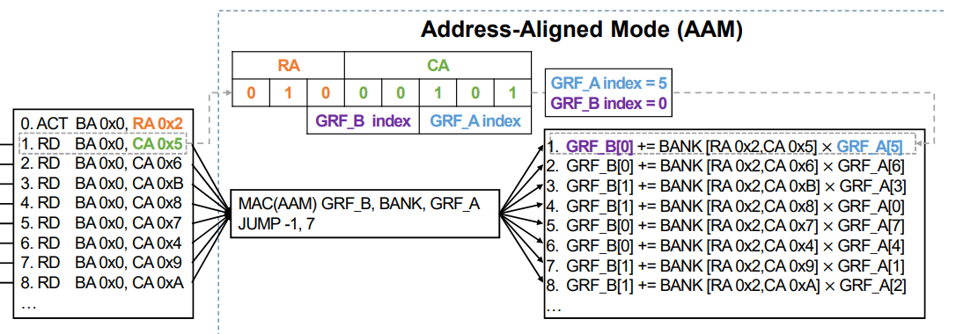
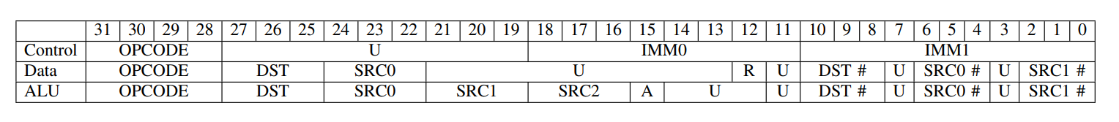
Research work—Challenge and Technique
PIM-DRAM Architecture.
Instruction Set Architecture – Instruction ordering.
Allows us to compute 8 MAC operations in 2 instructions.
When ‘A’ is set, the source and destination operand fields (SRC0 #, SRC1 #, and DST #) are ignored and replaced with sub-fields of the row and column addresses of a DRAM command.

Slide 16
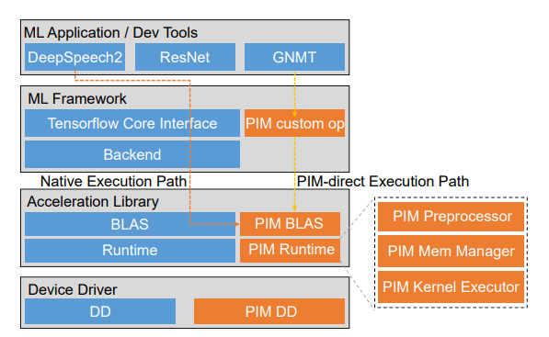
Research work—Challenge and Technique
PIM Software Stack And Programming Model.
Software stack – run unmodified source mode based on ML framework.
The blue ones are original software stack and the orange ones are additionally for PIM-DRAM.
Operation steps
First, the PIM device driver reserve memory space for PIM-DRAM.
Second, the PIM BLAS supports a set of common linear algebra operations that can exploit PIM on the PIM runtime and make users utilize PIM execution unit without knowing how to handle PIM.
Third, the PIM runtime is a set of user-level modules used by PIM-BLAS function.
(a)PIM preprocessor
(b)PIM Memory Manager
(c)PIM Kernel Executor

Slide 17
Research work—Challenge and Technique
PIM Software Stack And Programming Model.
Software stack – run unmodified source mode based on ML framework.
PIM preprocessor analyzes the source code of application and finds TF ops suitable for PIM at runtime.
PIM memory manger governs the memory allocated by the PIM driver, stores CFR commands and operand data in cache area for later use.
PIM kernel executor configures and invokes a PIM kernel.

Slide 18
Research work—Challenge and Technique
PIM Software Stack And Programming Model.
Software stack – run unmodified source mode based on ML framework.
PIM custom op is implement as part of the Tensorflow framework for explicit and manual use of PIM operations.
Currently support six custom TF operations : ADD,MUL,ReLU,LSTM,GEMV and BN

Slide 19
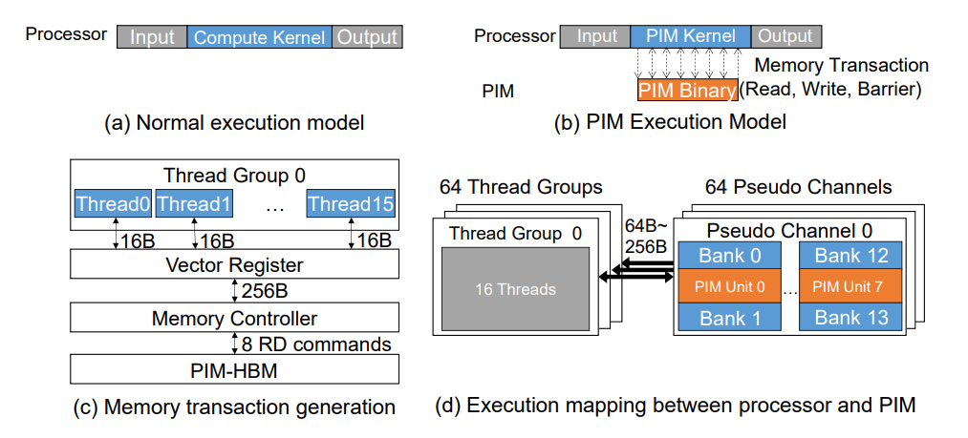
Research work—Challenge and Technique
PIM Software Stack And Programming Model.
Programming Model.
Normal execution model : PIM kernel send memory request to DRAM.
To fully utilize the compute throughout of PIM-HBM, we create multiple threads, each send 8 memory requests to a contiguous memory region of 256 byte.
If the max memory access is 16byte, we need 16 thread for accessing 256byte at a time, totally need 16*64=1024 threads.

Slide 20
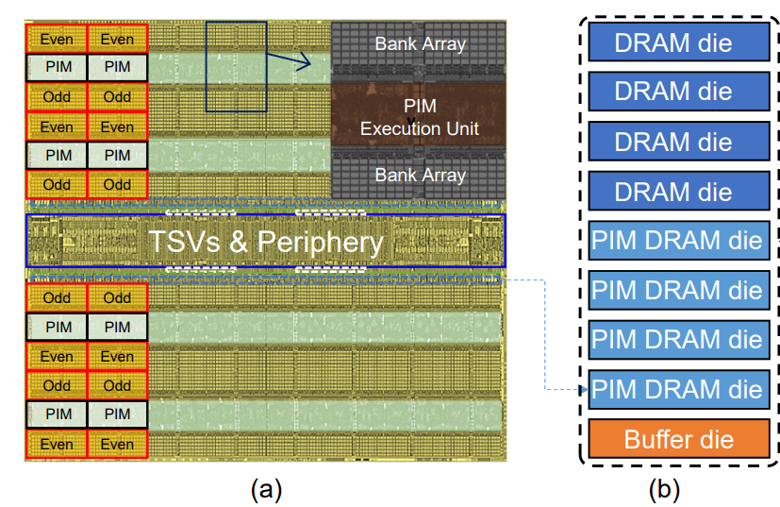
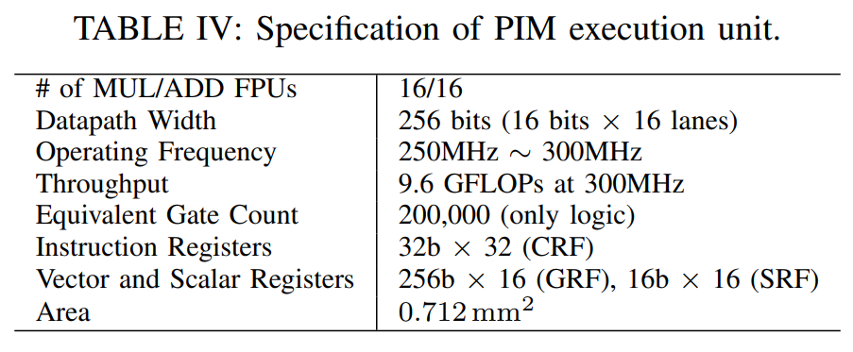
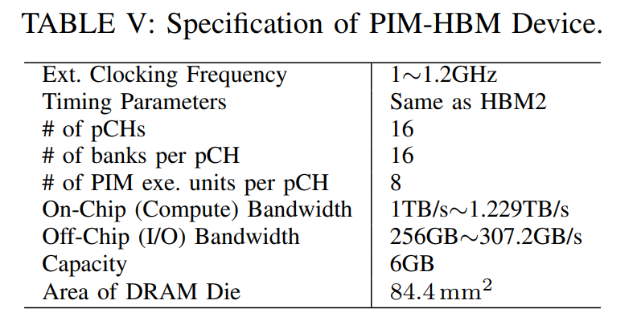
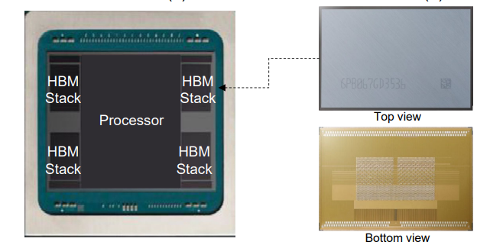
Research work—Challenge and Technique
Chip implement and integration with a system.

Slide 21
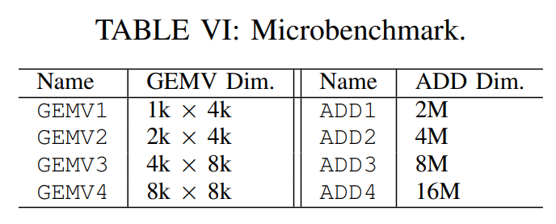
Research work—Evaluation
Benchmark.
GEMV.
ADD.
Baidu’s DeepSpeech2(DS2).
Google’s Neural Machine Translation System(GNMT).
Google’s RNN Transducer(RNN-T).
AlexNet.
ResNet.
Focus on the batch size is 1.
Larger batch size give more data reusability(high LLC hit rate) which makes a application more compute bound.
PIM-HBM for memory-bound/latency-sensitive application such as online services.

Slide 22
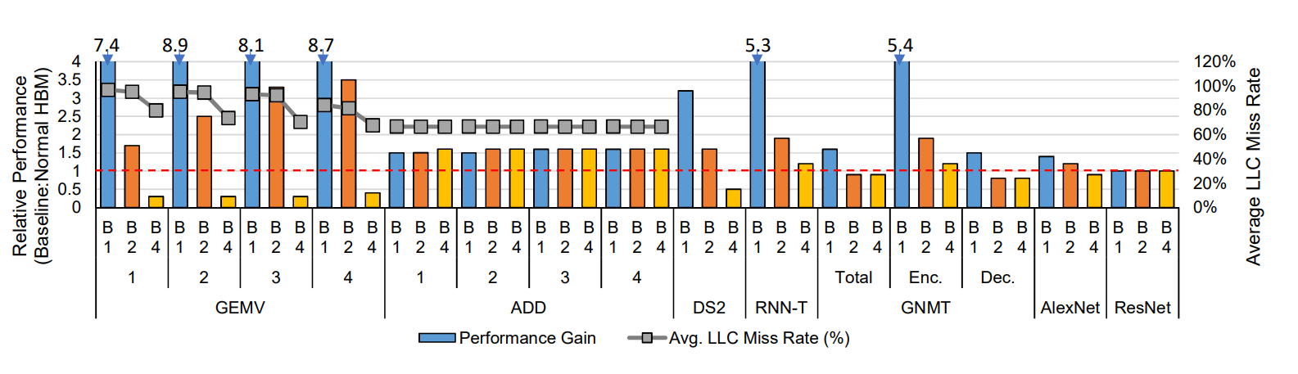
Research work—Evaluation
Performance.
The PIM-HBM-based system give 1.4~11.2 higher performance than HBM.
PIM-HBM improves the performance of ADD by only 1.6x because ADD kernel uses both operands only by ones and the results should be stored to the bank after 8 ADD instructions which is limited by the number of GFR registers.
For ResNet-50 PIM-HBM gives the same performance than HBM because ResNet50 is dominated by Conv layers.

Slide 23
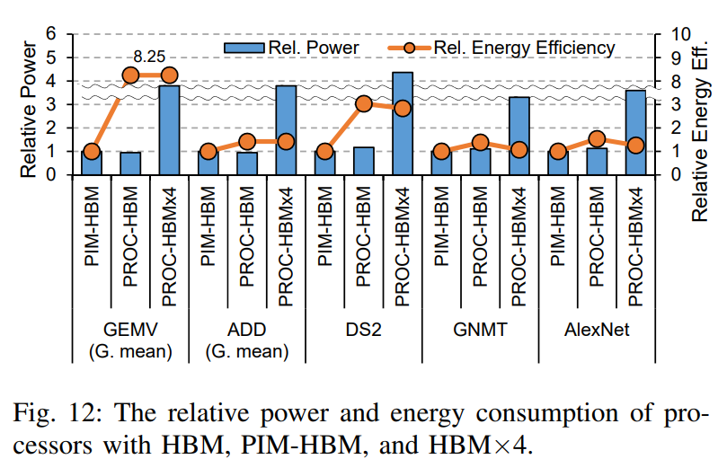
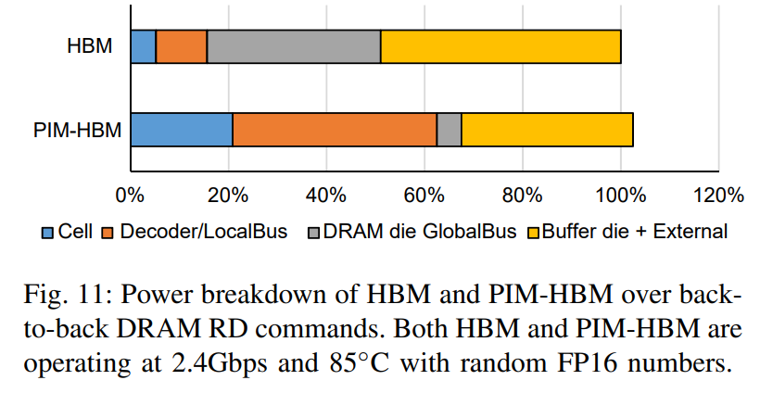
Research work—Evaluation
Power and Energy.
The PIM-HBM consume only 5.4% higher pow consumption even with 4x higher bandwidth than HBM.
The power consumption of cell and Decoder/LocalBus increases proportationally.
The power consumption of DRAM die GlobalBus and Buffer die + External decreases.
Theoretically, the power consumption of PIM-HBM can 10% lower than HBM after eliminating unnecessary power
consumption by the buffer die’s 1024-bit data I/O circuit that does not need to toggle in PIM mode.

Slide 24
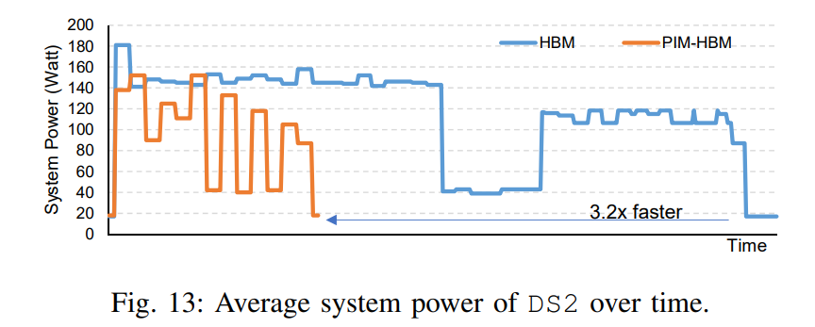
Research work—Evaluation
Power and Energy.

Slide 25
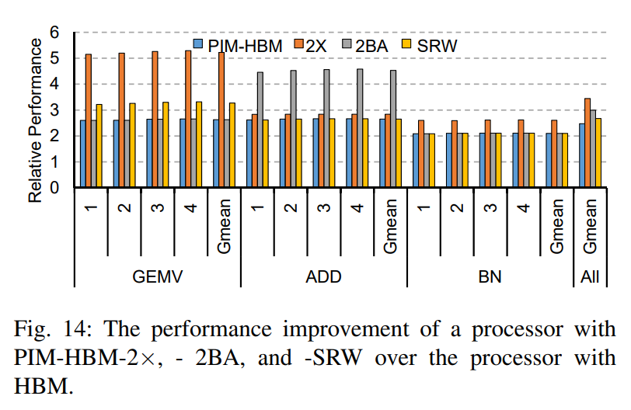
Research work—Evaluation
Design Space Exploration.
2x-provide 2x more resources.
2BA-access the EVEN bank and ODD bank simultaneously to get two operands from one PIM instruction.
SWR-get 32-byte data from WR command and another 32-byte data from column address of the EVEN BANK and ODD bank .

